Slide 1

Inventory forecasting
Client Project (PRCL-0027-INVEN-FORE)
Team ID: 1102

Slide 2

Objective
The business case is on the inventory management. Keeping Inventory of spare in various service center to the market demand is always a challenge as most service centers spends significant amount in spare parts inventory costs. In spite of this, availability of spare parts is been one of the problem areas.
Create Predictive model for bike service centers inventory forecasting

Slide 3
Our Approach
Exploratory Analysis
Modeling with all features
Feature Selection
Modeling with engineered dataset
Standard Approach

Slide 4

Exploratory Analysis
Standard Analysis

Slide 5
Overall Spares Consumption
Overall Spares Consumption
Challenges:
- There is no clear target provider in dataset
- Our first challenge is to create meaningful target that correlates to input features
- In order to achieve JIT Inventory model, we would need spares in hand, MIN, MAX, lead time & cost etc.
- We are missing everything in this dataset
- Lets try create a meaningful dataset based on this raw data - else proceed with univariate time series approach considering only data point that is spares consumption. This will not give leverage to find when and where we need how many!
Spares | Count of #spares | %
ENGINE OIL | 3802 | 13.36%
CHAIN LUBRICATION | 3441 | 12.10%
GENERAL SERVICE | 2142 | 7.53%
AIR FILTER | 1715 | 6.03%
3M OIL | 1628 | 5.72%
CONSUMABLES | 1595 | 5.61%
POLISH | 1245 | 4.38%
DISC OIL | 991 | 3.48%
BRAKE SHOE | 965 | 3.39%
OIL FILTER | 821 | 2.89%
DISC PAD | 575 | 2.02%
WHEEL RUBBER | 521 | 1.83%
AIR FILTER CHECKUP | 467 | 1.64%
SPARK PLUG | 421 | 1.48%
CHAIN SPROCKET | 396 | 1.39%
SPROCKET RUBBER | 347 | 1.22%
CLUTCH CABLE | 341 | 1.20%
SPROCKET BEARING | 314 | 1.10%
CHAIN OVERHAUL | 284 | 1.00%
CLUTCH ASSEMBLY | 212 | 0.75%
Other 477 spares | < 200 in qty | 21.88%
Total | 28448 | 100.00%
Spares | Count of #spares | %
BAJAJ PULSAR 150 | 8614 | 30.28%
BAJAJ AVENGER STREET 220 | 4212 | 14.81%
BAJAJ PULSAR 220 | 2654 | 9.33%
BAJAJ PULSAR 180 | 2251 | 7.91%
BAJAJ PULSAR NS 200 | 2203 | 7.74%
BAJAJ CT 100 | 1432 | 5.03%
BAJAJ DISCOVER 125 | 1345 | 4.73%
BAJAJ AVENGER STREET | 1111 | 3.91%
BAJAJ PLATINA | 843 | 2.96%
BAJAJ V150 | 685 | 2.41%
BAJAJ DISCOVER | 678 | 2.38%
BAJAJ PULSAR LS135 | 518 | 1.82%
BAJAJ PULSAR AS 200 | 421 | 1.48%
BAJAJ PULSAR NS 160 | 364 | 1.28%
BAJAJ PULSAR RS 200 | 322 | 1.13%
BAJAJ DISCOVER 150 | 282 | 0.99%
BAJAJ AVENGER STREET 180 | 122 | 0.43%
BAJAJ DISCOVER 135 | 115 | 0.40%
BAJAJ V125 | 95 | 0.33%
BAJAJ V | 51 | 0.18%
BAJAJ CALIBER | 40 | 0.14%
BAJAJ XCD 125 | 27 | 0.09%
BAJAJ V15 | 23 | 0.08%
BAJAJ XCD 135 | 13 | 0.05%
WAVE | 10 | 0.04%
BAJAJ DOMINAR 400 ABS | 7 | 0.02%
BAJAJ WIND 125 | 6 | 0.02%
BAJAJ BOXER CT | 4 | 0.01%
Total | 28448 | 100.00%
Observation 1: The most used consumables are Engine Oil and Chain Lubrication, others sharing very least % of overall consumption
Observation 2: Bike models Bajaj Pulsar 150 and Avenger street 220 consumed the maximum % of overall consumption
Dataset contains following unique attributes
1305 | Bikes
800 | Dealers
496 | number of spares
28 | Bike model

Slide 6
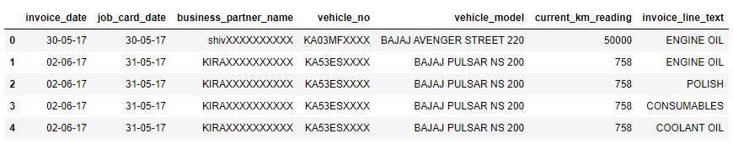
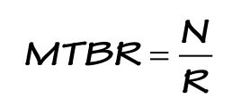
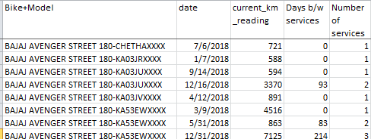
Data Preparation
Original input – raw data
If we consider sum of spares as a target column, the Mean Time Between Repairs (MTBR) shall be a good correlated feature that could help building regression model
How to calculate MTBR?
We calculate number of days b/w services
Number of services involved per vehical_no + model
N = Total number or services
R = number of repairs per bike+model *
* Vehical_no alone will not sufficient as true number has been masked with XXXX so concatenating with vehicle model as well
For example: Refer to MTBR_Calc sheet

Slide 7
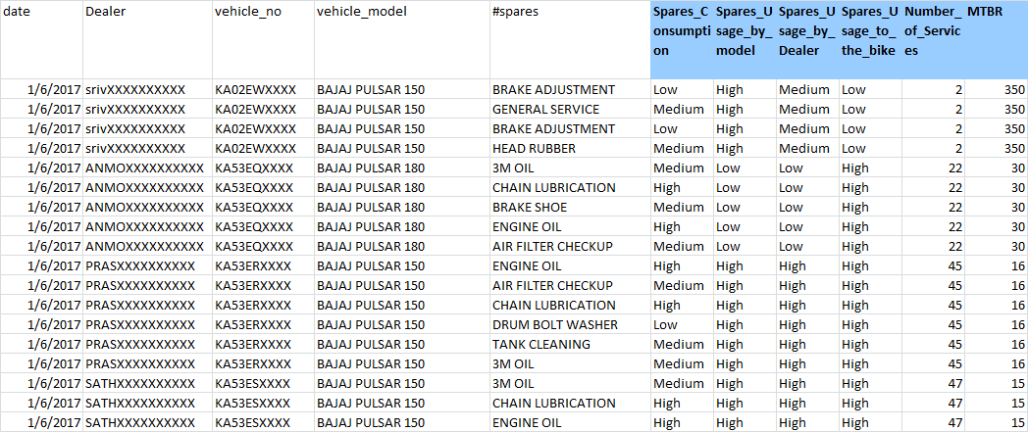
Reconciliation of Dataframe
* Refer to new_dataframe sheet

Slide 8
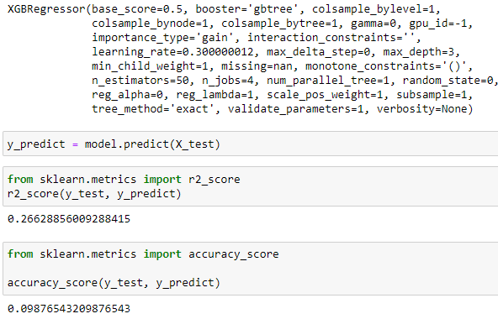
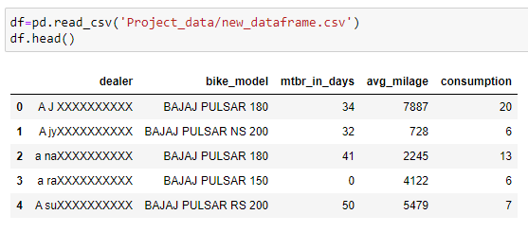
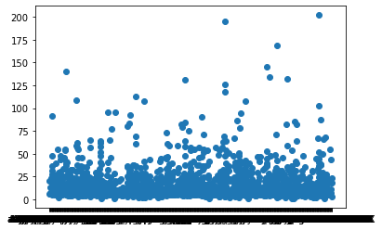
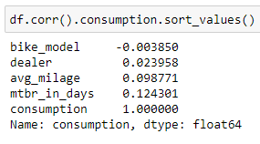
Regression model (XGBRegressor)
Input: new_dataframe.csv
R2 Score: 26% with very low accuracy
Program file

Slide 9
Summary of Regression model: Due to the inputs constrains the regression models not performing good, lets try Time series models

Slide 10
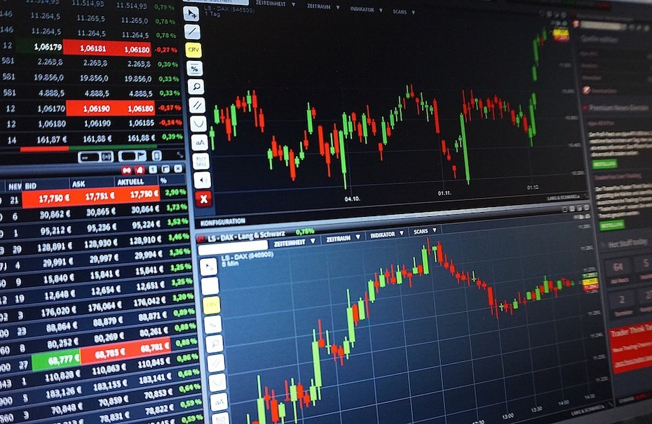
Time series approach
An alternate approach to try predict number spares required in future considering only time

Slide 11
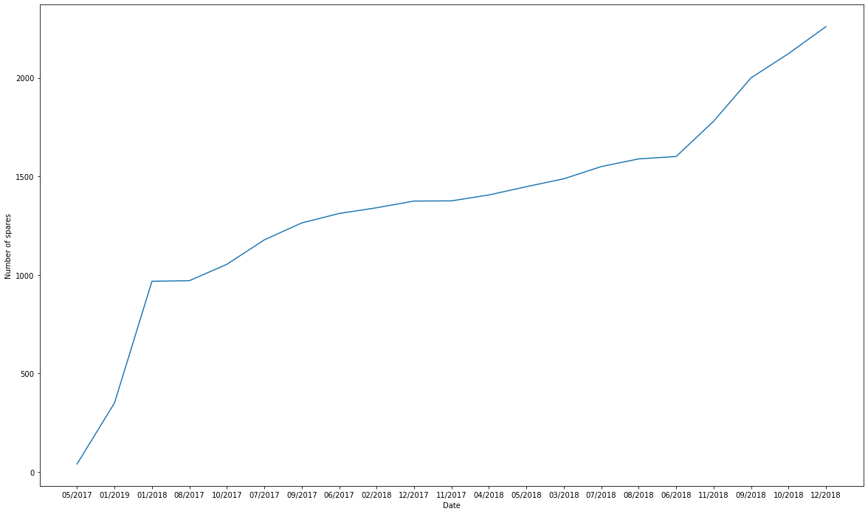
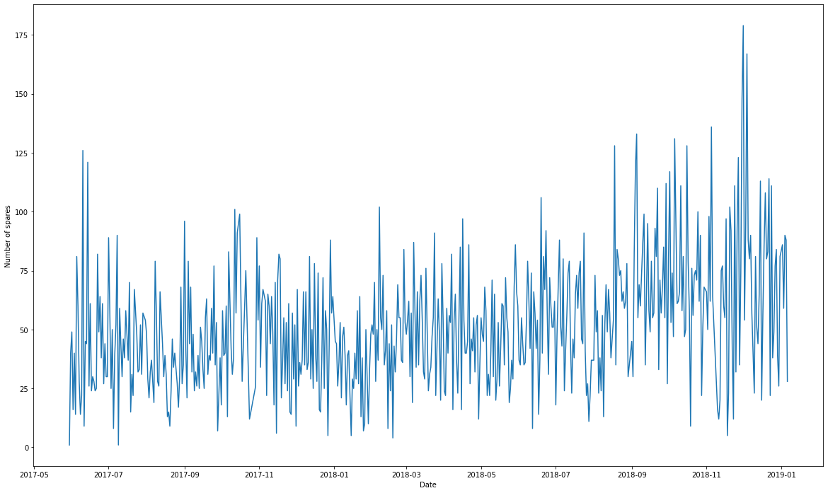
Time Series Analysis (Fact Check)
Forecasting involves taking models fit on historical data and using them to predict future observations
Time series data often requires cleaning, scaling, and even transformation
Time should have equal intervals daily/weekly/monthly etc..
Time series data analysis involves identifying at least three insightful aspects of the data. These factors are autocorrelation, seasonality, and stationarity
Autocorrelation - is the tendency of data observations and patterns to repeat themselves
Seasonality - is when observations and patterns repeat themselves at regular intervals
Stationarity - is a measure of how little a time series’ mean and variance changes over time
When group the number spares used across the dealers by months we get only 21 records in dataframe
When group the number spares used across the dealers by date we get 553 records in dataframe

Slide 12
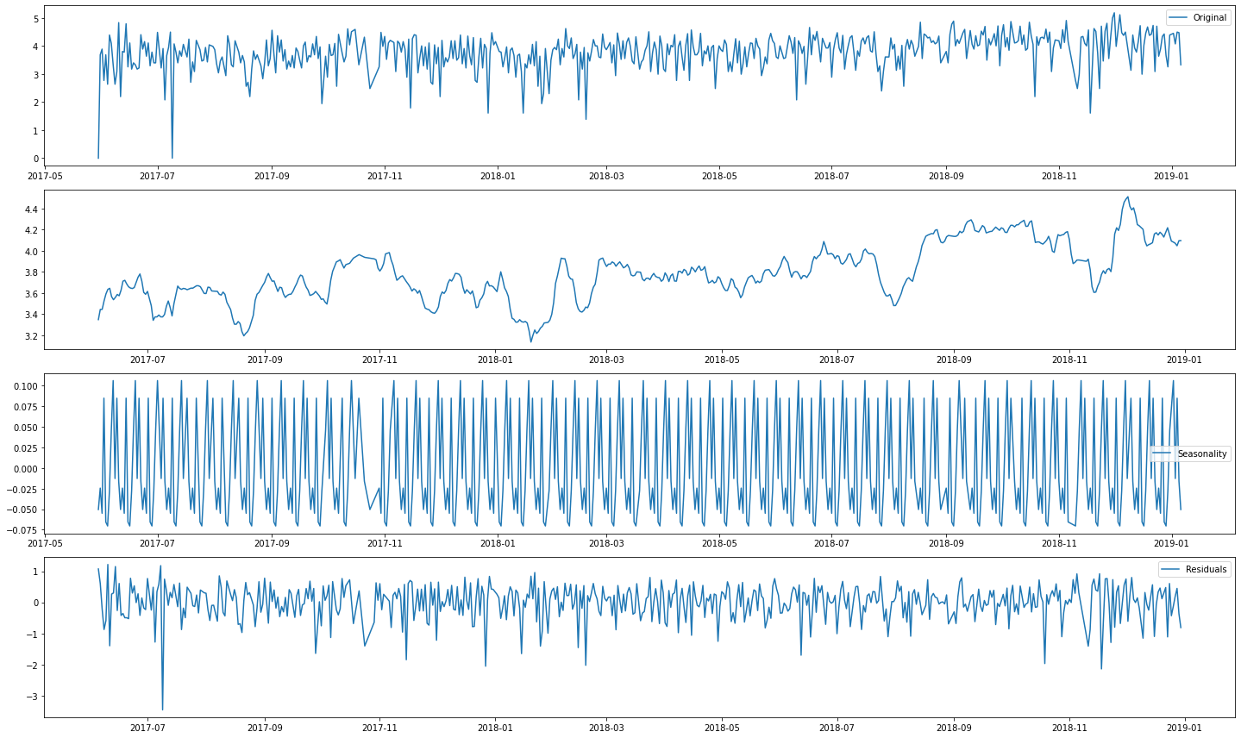
ARIMA Model
Trend

Slide 13
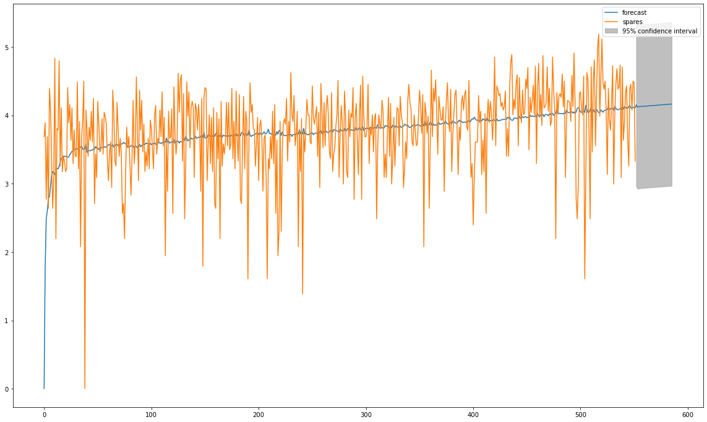
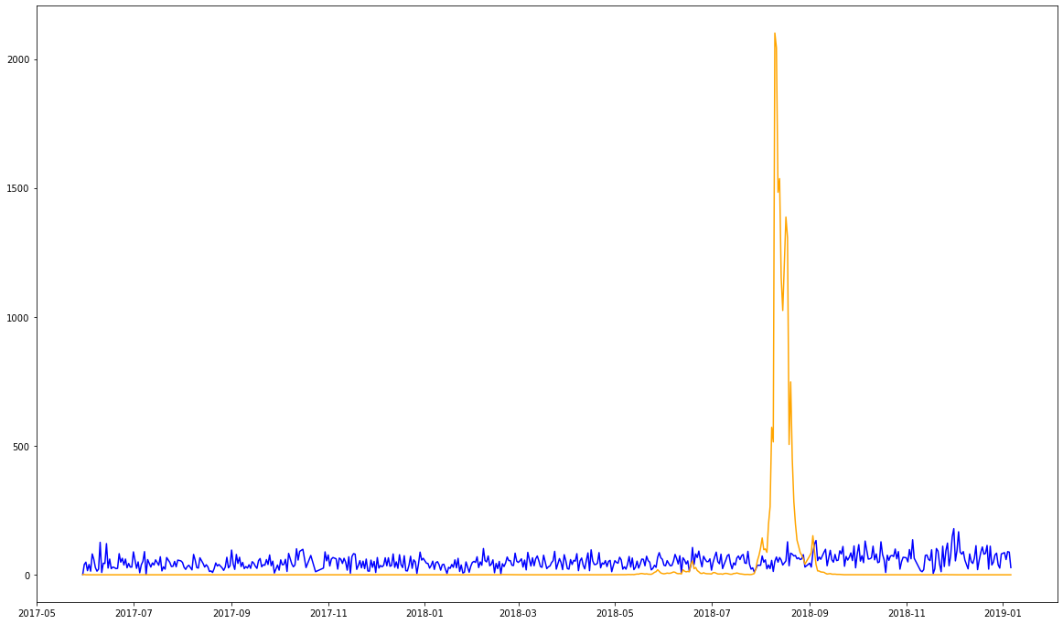
ARIMA – Prediction for next 3 months
Program file

Slide 14
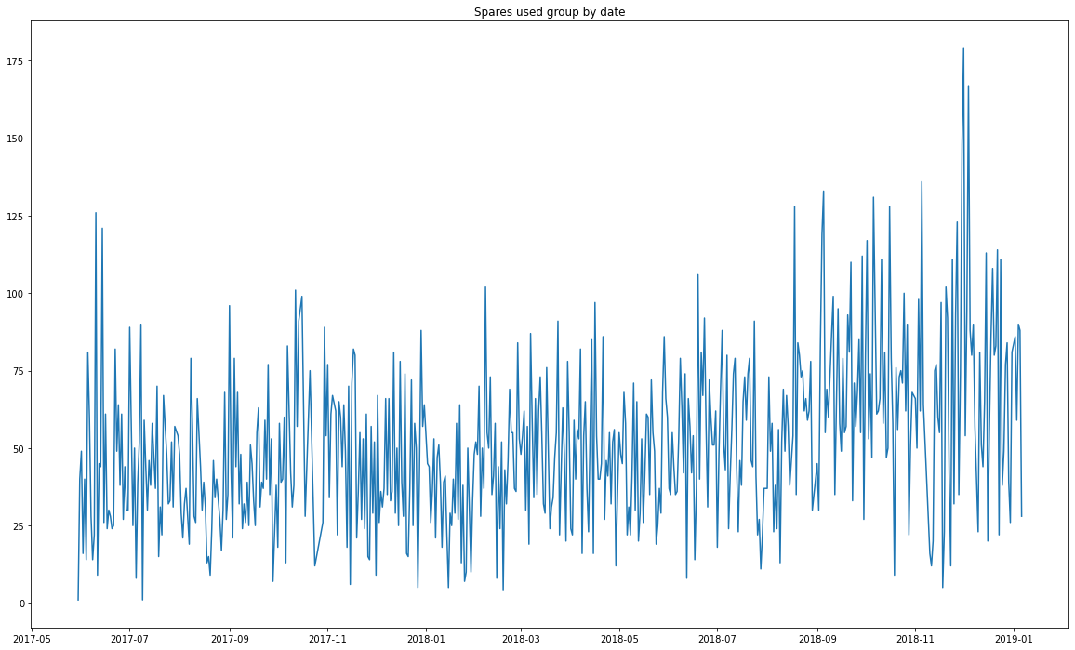
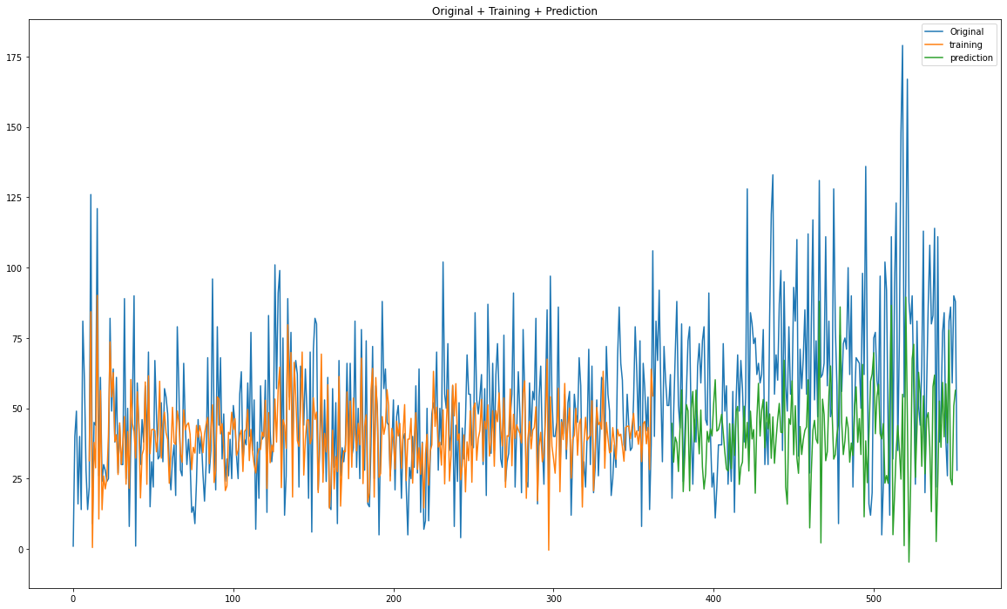
Feed Forward Neural Network - model
Program file

Slide 15
Summary of Time Series model: The feed forward neural network seems to be a better model predicting spares requirements across the dealers with good accuracy. But with time series we can’t exactly predict how many spares required at specific service station!

Slide 16
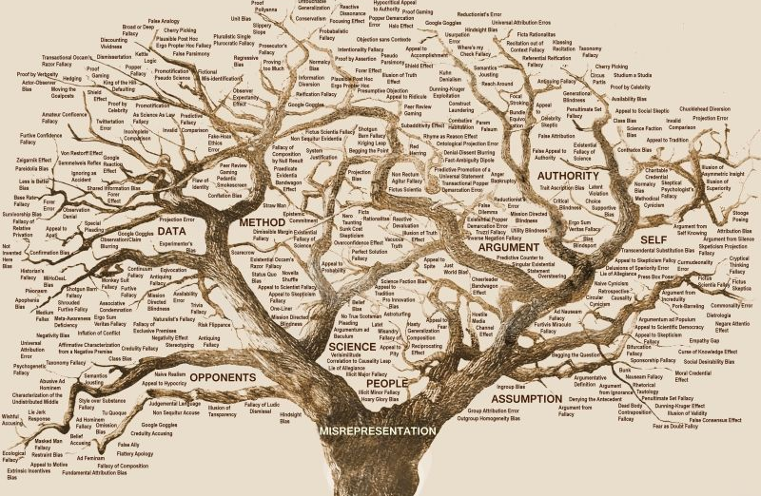
Random Forest for Time Series Forecasting
No algorithm works best for all the datasets… Random Forest is a popular machine learning algorithm belongs to the supervised learning technique.. Lets try this out

Slide 17
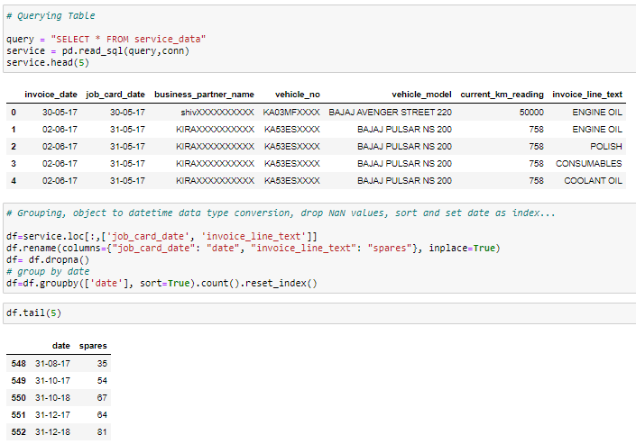
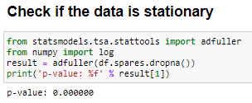
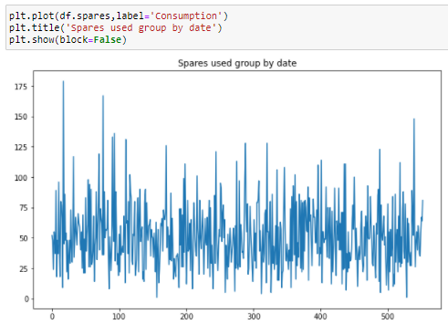
Modeling
p < .001 that means the results were highly significant. it suggests there is zero chances of getting results if null hypothesis is true. there is less chances of getting results
Since the p-value is below 0.05, the data can be assumed to be stationary. Hence we can proceed with the data without any transformation

Slide 18
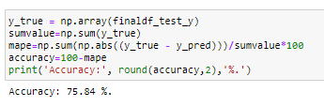
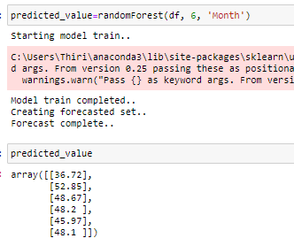
Evaluation & Prediction
We will predicting spares for future 6 months.
The lags will be null for future date points so
we have to predict for one month at a time and
use the predicted spares for creating lag for next month’s prediction and so on.
Please note we are using the predicted spares only to create the lag variable
Program file

Slide 19

Large image
Final Summary:
Considering the input data limitations we have tried generate a meaningful datasets for multiple machine learning algorithms such as LinearRegression, xgboost Regressor, ARIMA, LSTM, Feed Forward Neural Network and Random Forest for Time Series Forecasting.
Despite input data challenges the random forest model works better for even time series problems with ideal accuracy.

Slide 20

Thank You

